Slide 1


Optum Stratethon-Season 3
BitMagic

Slide 2
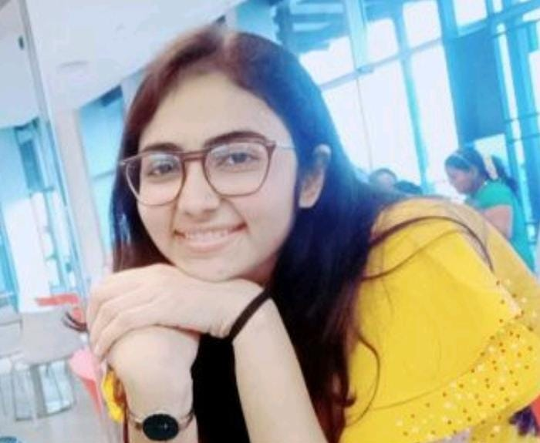
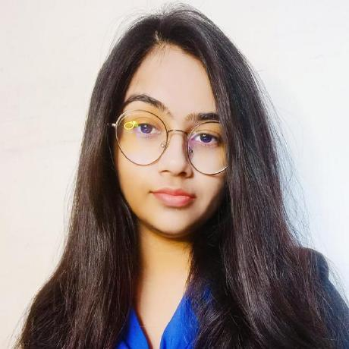
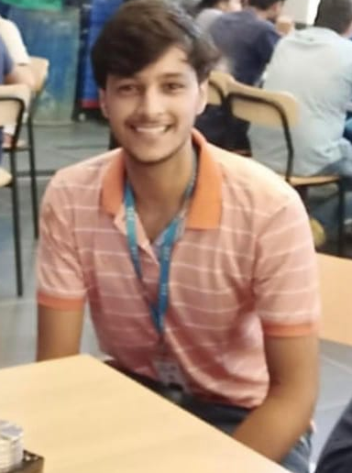
Dhyani Desai
BITMAGIC
Joyeeta Dey
Karmanya Tyagi

Slide 3
Business Problem & Solution
Medication nonadherence is a complex problem that stems from several factors including the healthcare system, disease-related conditions, therapy-related factors, socioeconomic status, and the patients themselves. Medication nonadherence is a growing concern to clinicians, healthcare systems, and other stakeholders (eg, payers) because of mounting evidence that it is prevalent and associated with adverse outcomes and higher costs of care.
Hence our solution for ensuring medical adherence should include the following points:
Data Analytics on given dataset to find the category of population falling into the category of non-adherence
Smart Pill Reminders and Refill Alerts
Predicting the type of non-adherence using predictive analytics and behavioral technology can be considered to give patients the personalized support they need to achieve greater adherence
Creating an engaging UI/UX experience (visually interactive for minorities and illiterate population to understand)
Tracking the progress of patients and their peers progress to identify where they have reached in their treatment journey through gamification.
Imparting basic knowledge regarding medicine storage, medical equipment usage , false assumptions through various gamification approach .
Reward system based engaging portal that keeps the patients motivated to complete their medication journey on time.

Slide 4
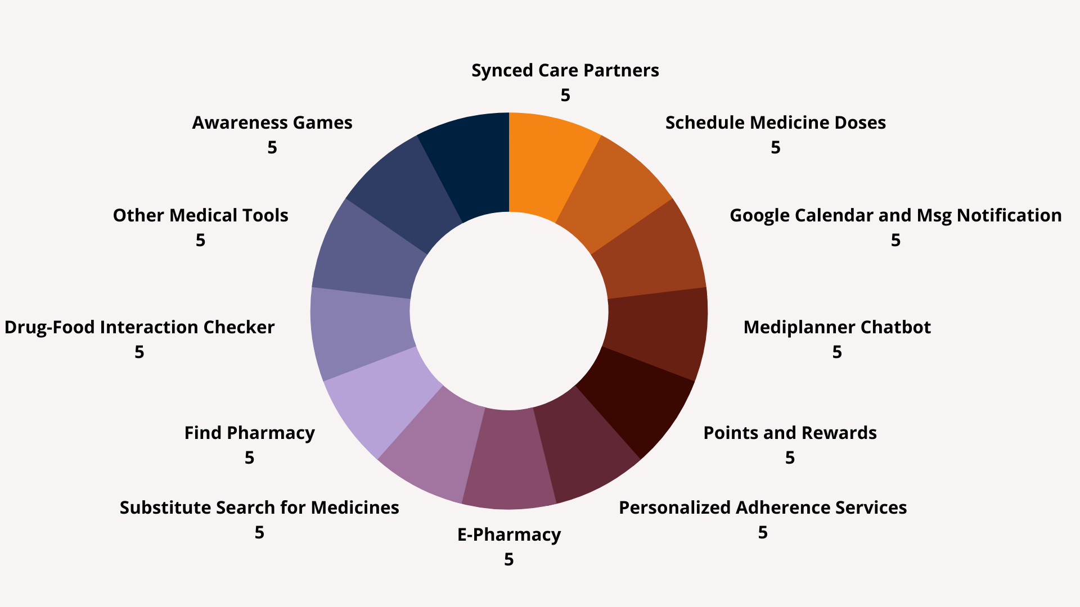


Slide 5


PillPlan At a Glance
PillPlan has Synced Care Partner so that your family member or health care provider can keep track of your medicines for you.
I don’t usually like to take medicines….My mom mostly keeps track of it for me
I am so busy I don’t remember taking my medicines on time...its very difficult for me to keep track
PillPlan has Medicine Reminder (sms and web) and Google Calendar Sync so that you are timely alerted for your medicine doses even when you are busy.

Slide 6
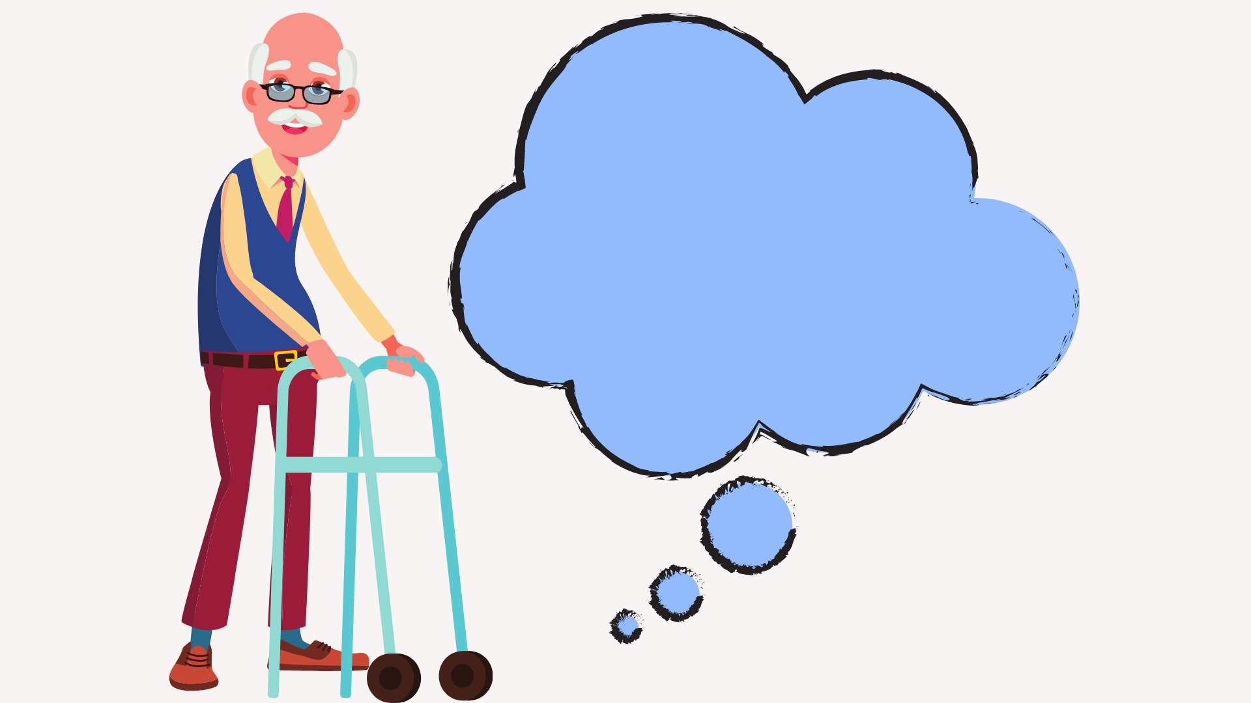
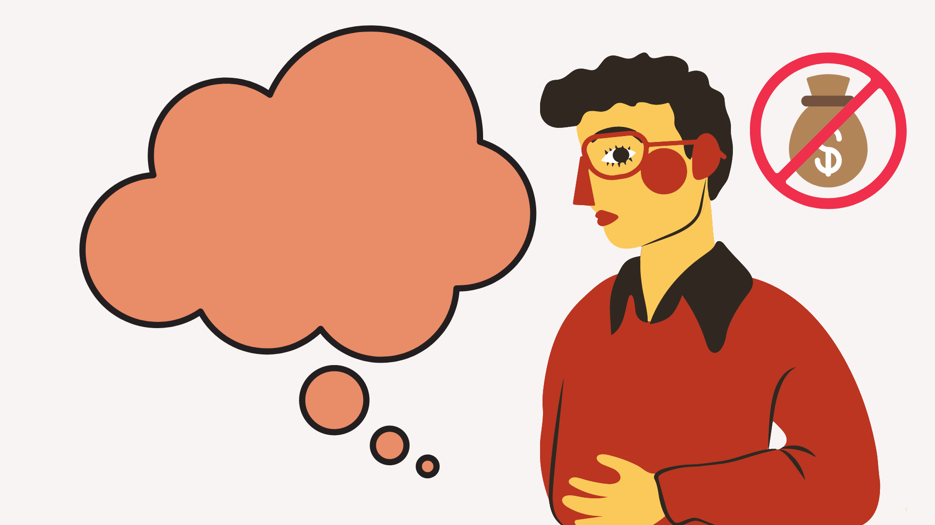
PillPlan At a Glance
PillPlan has Volunteer Services and E-pharmacy for old people and disabled are provided the option for booking themselves volunteer services.
I am so old and weak that I cannot take my medicines myself or buy them from store..
I am not financially strong enough to buy my medicines every month
Patients with lack of financial support are directed to find themselves a better healthcare plan

Slide 7
Impact of Medical Adherence
Medication adherence plays an important role in disease management, especially for diabetes.
A total of 1 million diabetes mellitus patients were randomly selected from the National Health Insurance Research Database between January 1, 2000 and December 31, 2004. All records with missing values and those for participants under 18 years of age were then deleted. Because many patients had multiple clinical visit records, all records within the same calendar year were summarized into 1 single record for each person. This pre-processing resulted in 14,602 total patients with a combined 73,010 records over the course of 5 years.
The demographic characteristics examined for each patient include gender, age, residential area, and socioeconomic status.
Our analysis of how demographic variables impacted nonadherence revealed that elderly patients exhibited better overall medication adherence, but that male patients exhibited poorer medication adherence than female patients.
Next, our analysis of how nonadherence impacted health status revealed that patients who exhibited medication nonadherence had poorer health status than patients with proper medication adherence.
Finally, our analysis of how nonadherence impacted medical expenses revealed that patients who exhibited medication nonadherence incurred more medical expenses than those who exhibited proper medication adherence.
This indicates the need to improve patient attitudes toward medication adherence, which can have substantial effects both medically and economically.

Slide 8
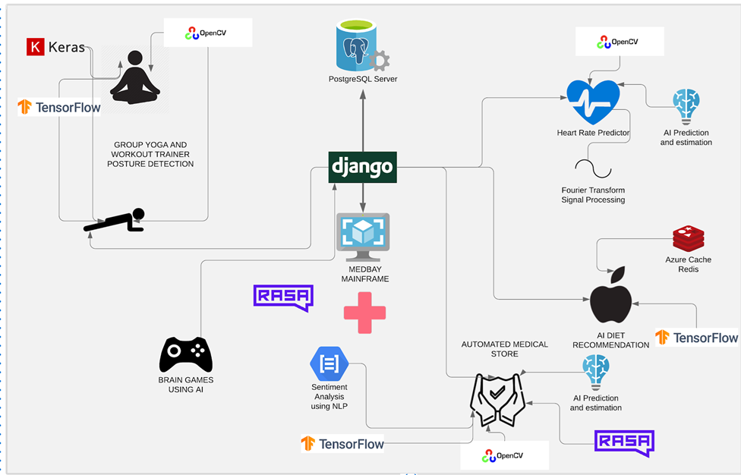

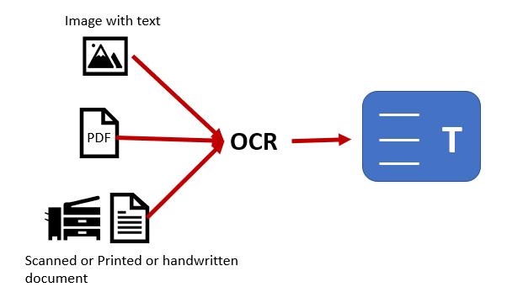
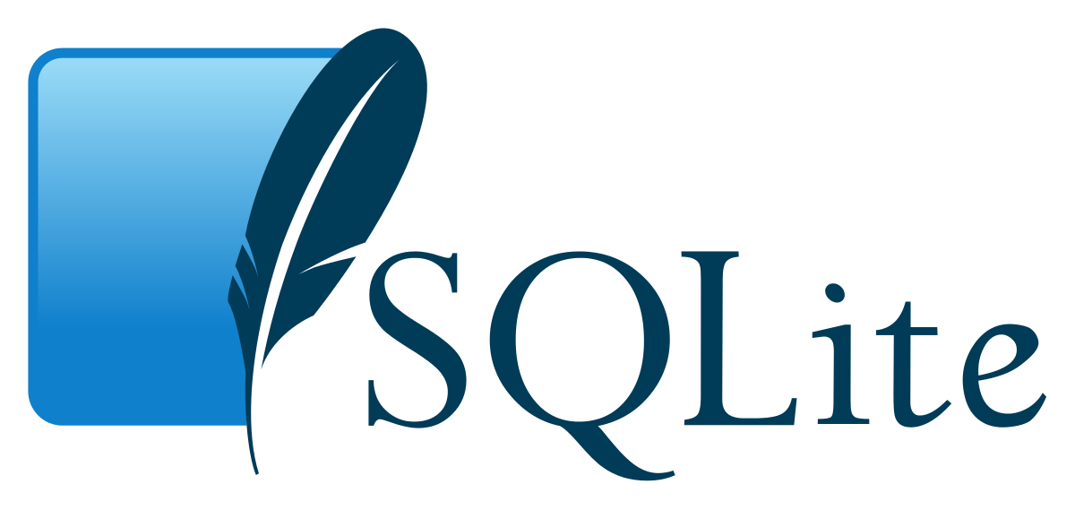

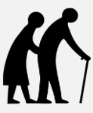
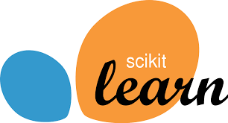


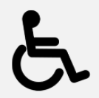





Architecture
Food allergy checker from food label photo
personalization for intentional and unintentional adherence
gamification rewards and points

Slide 9
WHAT MAKES PILL PLAN DIFFERENT ? (USP)
GAMIFICATION FOR USER ENGAGEMENT AND KNOWLEDGE IMPARTMENT
DRUG-FOOD/INTERACTION FOR POSSIBLE DRUGS TAKEN BY THE USER
SMS ALERTS/SYNC WITH GOOGLE CALENDAR FOR DAILY PILL REMINDER AND ADHERENCE
MACHINE LEARNING BASED PERSONALIZATION FOR PREDICTING THE TYPE OF USER ADHERENCE
FINANCIAL AID THROUGH SUBSTITUTE MEDICATIONS
DEEP LEARNING BASED AI TRAINER
HUMAN FRIENDLY CHATBOTS FOR EASY NAVIGATION THROUGH THE SYSTEM AND INSTANT CHAT WITH DOCTORS.

Slide 10
Application Modules
INTELLIGENT PHARMACEUTICAL STORE
Our inbuilt pharmacy provides the following functionality:
Chatbot integrated system- A smart chatbot which can guide the users through the features of the page and answer the related questions of the user. They can also display medicines related to type and place order.
Upload Prescription. The user would be happy to have a possibility to upload the doctor’s prescription to his personal account. Thanks to this, he can more easily find the medicine he needs in your drug database.
Drug Info. Detailed information is needed about each drug.
Drugs Comparison. Also, the user would appreciate the possibility to compare different drugs (their effectiveness, price range, etc.)... which leads us to the next item.
Substitute Search. Sometimes the required drug is unavailable or too expensive, and in this case, the user needs to be able to find its effective substitute. That's when he needs a Substitute Search tool.

Slide 11
Application Modules
SYNCED CARE PARTNER
The “SYNCED CARE PARTNER” syncs your trusted contact with your schedule so that you are kept an eye on and do not miss your doses or face any issues.
This features is especially useful for people with memory disorders,like alzheimer's who tend to forget taking doses unintentionally, with this feature your loved ones can keep a track of your daily medication intakes. We have a gps tracker which is connected with google maps to track patients locations.
This feature is also very helpful for older people , as their children and caretaker who are synced with the application can keep an eye on prescription refill alerts that our system provides,and can restock their medicine for them and providing personal support from within the healthcare team.

Slide 12
Application Modules
SMART CHAT BOTS
MediTimer - Add medicines to google calendar in an easy and effective way with the help of MediTimer. Its a powerful chatbot which uses nlp to parse the user inputs and add it to the synced google calendar. The user can then receive notifications from Google Calendar in Phone. It also uses google text-to-speech feature which is very convenient for physically disabled people.
Doctor Finder- A chatbot which enables us to book a doctor appointment. You can either schedule your appointment or chat with the doctor now. This bot has human handoff feature which can then handoff the conversation to an online doctor.
CareBot - A carebot which guides you through the smart pharmacy. You can order products online with this chatbot. It also handles E-Pharmacy FAQ questions.

Slide 13
Application Modules
AI BASED EXERCISE/YOGA TRAINER
For faster recovery , physical health has also become an important aspect to focus on.
Our AI trainer comes with posture detector where exercises are taught and the user can then carry forward his/her fitness journey to have early recovery.
A counter is attached with each exercise maintaining the reps and the correctness of each one of them is maintained.
A scoring system based on the posture detection system running in real-time in the background. The user is awarded points based on the workout which are latter added to user score .

Slide 14
Application Modules
AI BASED DRUG-FOOD/BEVERAGE INTERACTION PREDICTOR
A drug interaction is a situation in which a substance affects the activity of a drug. These interactions may occur out of accidental misuse or due to lack of knowledge about the active ingredients involved in the relevant substances.
In our project after text-scraping from various official medical websites a database for drug-food/beverage interaction was created. After which the detailed study of SMILE structure of drug and applying unsupervised machine learning techniques a smart drug-food/beverage interaction is created.
Food-drug interactions can produce negative effects in safety and efficacy of drug therapy, as well in the nutritional status of the patients , hence this smart checker works towards proper and better recovery.
We have also developed a food-allergy checker which converts image of food-ingredients label to text using OCR and Pytesseract. Then we calculate the similarity index and apply nlp to check whether it contains any allergic ingredient or not.

Slide 15
Application Modules
AI BASED DRUG-DRUG INTERACTION CHECKER
Often when users take numerous medicines two drugs can interact with each other and can cause serious complications.
Mostly this occurs when the user is already taking a medication and along with it they take some over the counter medicine for another illness. These two medicines can interact and cause drug-drug interaction.
To prevent this, we have implemented a drug-drug interaction checker where the user can enter two drugs and if the two drugs causes interaction then the effects, alternative drugs, similar drugs and its remedies will be listed.
We have taken the DDI data from drugbank and are applying k-means and random forest to classify the drugs object and the precipitant drug causing the interaction.

Slide 16
Application Modules
USER-FRIENDLY PILL REMINDER AND PRESCRIPTION
TRACKER
Pill Plan also has a medicine reminder which keeps track of your medicines and sends timely reminder sms alerts so that you never miss a dose.
The user needs to enter the medicine details only once. We keep track of your frequency of medicines per day and timely send you sms alerts to remind you. this form is very visually attractive so that it is easy for users to understand and use.
We also keep track of the prescription refill and expiry date of your drug to timely alert you.
The medicines are sorted according to the frequency and time slot of the day for the ease of the user.

Slide 17
Application Modules
GAMIFICATION POWERED PATIENT MEDICATION JOURNEY TRACKER
To maintain engagement throughout each stage of medicine doses,we provide a gamified approach with friendly competition with your peers to see how far have you and your peers reached in your medical adherence journey.
To keep a user motivated the applied gamification at every point of our webapp , provides exciting coupons and vouchers that can be redeemed and more of such can be unlocked as the user completes the medications regularly ensuring constant adherence.
The user dashboards basically sums up small details of the patient's medications journey.The analytics taken from weekly input of a user show a visual representation of how adherent the user has been in the past week , the average number of doses missed and average number of doses completed , the level user has reached in the medication journey and points earned uptill now

Slide 18
Application Modules
GAMIFICATION SIMULATED FUN-LEARN CORNER
Medical non-adherence is many times also triggered by lack of basic knowledge of improper uses of medication devices or using expired damaged or improperly stored medicine.
To tackle this problem the FUN-Learn corner provides awareness regarding such issues by engaging the patient through fun games from which they earn points to stay motivated on their treatment journey.
For faster recovery physical health also plays a major role in medical adherence , hence we present a AI based trainer to help you gain physical strength while earning reward points .

Slide 19
Application Modules
MACHINE LEARNING BASED PATIENT BEHAVIOUR PREDICTOR
In general non-adherence may also be categorized based upon the patients’ intent to consume medication; known as intentional and unintentional. These types of non-adherences must be treated differently due to the variety of underlying factors.
We conducted a patient survey based on standard questionnaires like MARS,CRS,BARS ,DAI etc to which SVM an Naive Bayes machine learning techniques were applied to predict the category of patient behaviour towards medical non-adherence.
After a user finds out the type of non-adherence path one follows, a personalized support is provided for each user.
Patients with lack of financial support are directed to find themselves a better healthcare plan, patients with linguistic barriers are introduced to a multilingual system, old people and disabled are provided the option for booking themselves volunteer services.
Similarly patients that are classified as intentionally leaving the medication course, are provided with a gamified solution of mythbusters where they are rewarded points for developing a better mindset leading to the path of medical adherence.

Slide 20
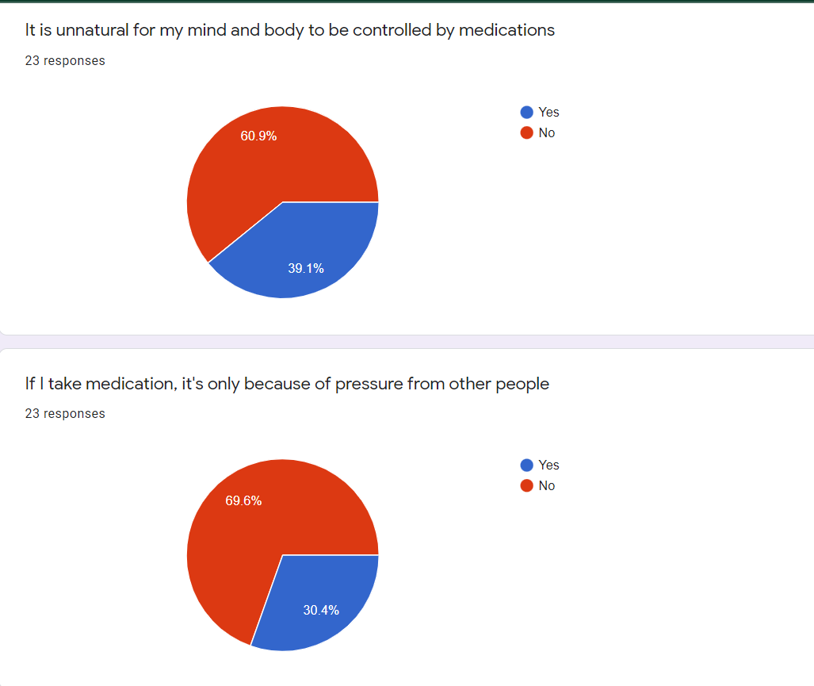
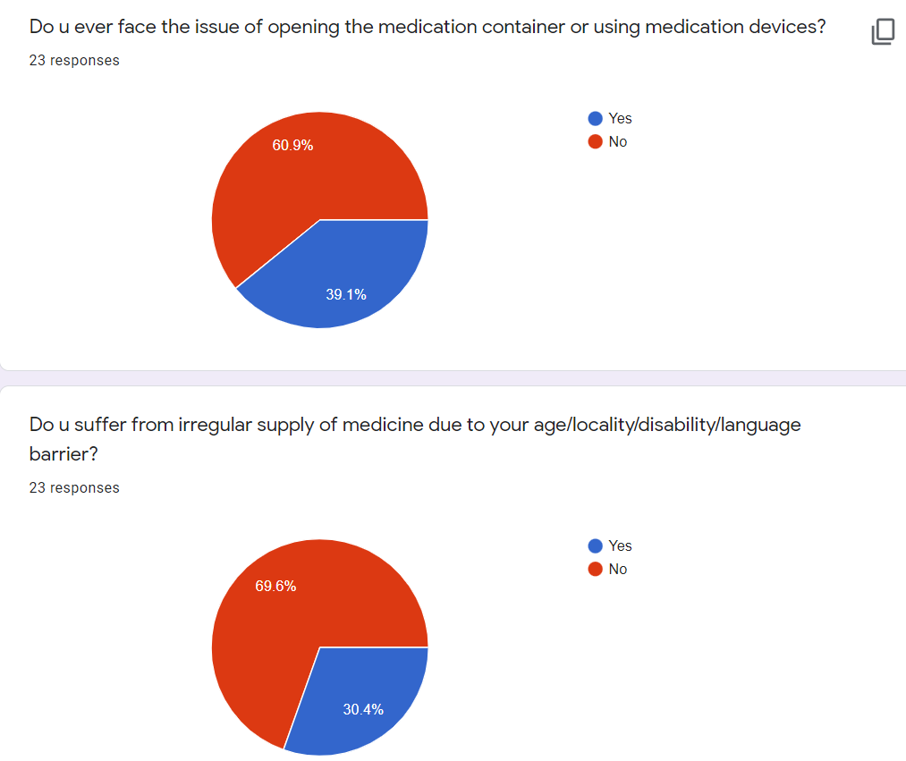
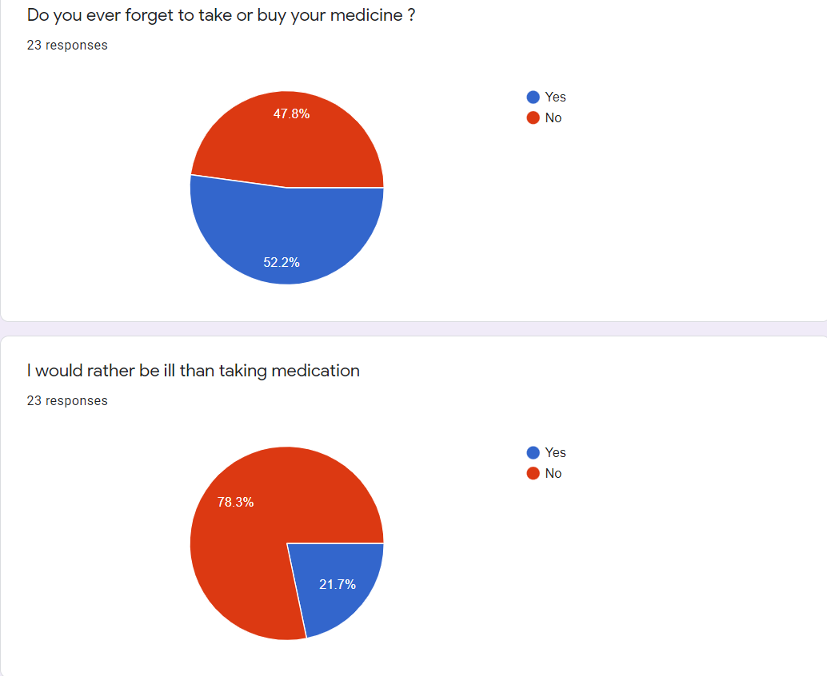
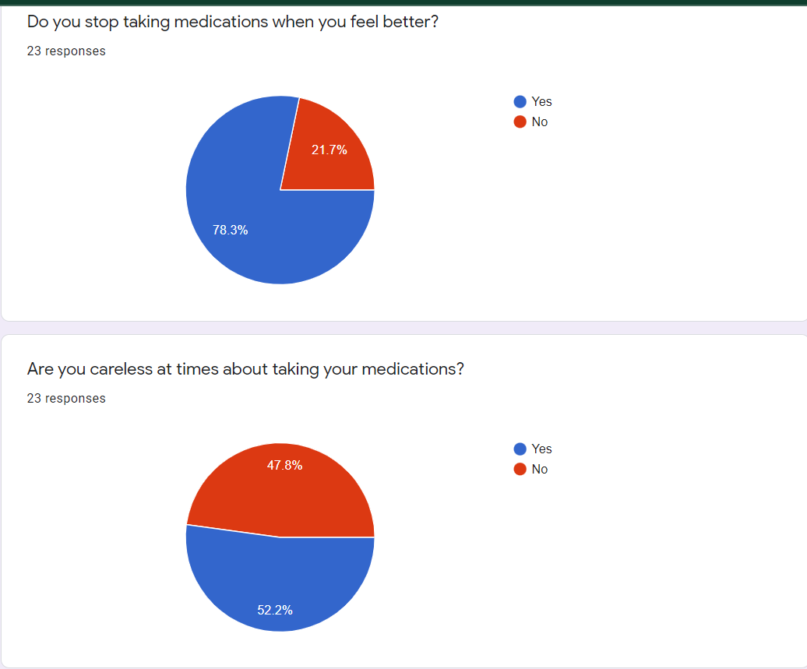
Application Modules
SURVEY - DATA COLLECTED GOOGLE FORMS

Slide 21
Application Modules
OTHER SMALL MODULES
BMI CALCULATOR : Our web application also gives patient the feature to calculate his/her BMI and know whether they are fit or not.
EMERGENCY AMBULANCE CALLING FACILITY : In the time of emergency , if you are alone at home then by pressing the emergency button will send an alert to the nearest ambulance which will be at your doorstep within 15 minutes.
VIDEO CALLING FACILITY : A doctor-patient video call system , so that a patient can consult his/her doctor anytime he/she wants.

Slide 22
Major Tools Used
Django
HTML,CSS,Javascript
Bootstrap,Ajax,JQuery etc.
Machine Learning Algorithms: Naive Bayes Classifier, Support Vector Machines,XGBoost Algorithms
Dijkstra's Algorithm and Shortest Time path Algorithms
Content-Based Recommendation System
Deep Learning Posture Detection Algorithms,Tensorflow,Open CV
NLP Sentiment Analysis Model
GTTS module, celery, Google Geolocation
Python ML,DL libraries
Beautiful Soup , Web Scraping

Slide 23
Visualization of user trends using data analytics to find out population based upon demographic, ethnicity, gender and so on with highest contribution to non-adherence.

Slide 24
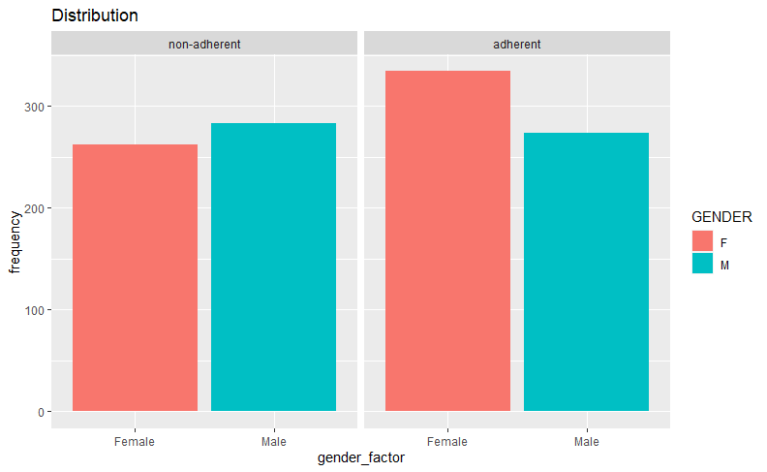
Studies show that female are more adherent to taking medicines than male and factor which can contribute towards this is that more number of male are working during the days and therefore prone to not taking medications due to work issues.

Slide 25
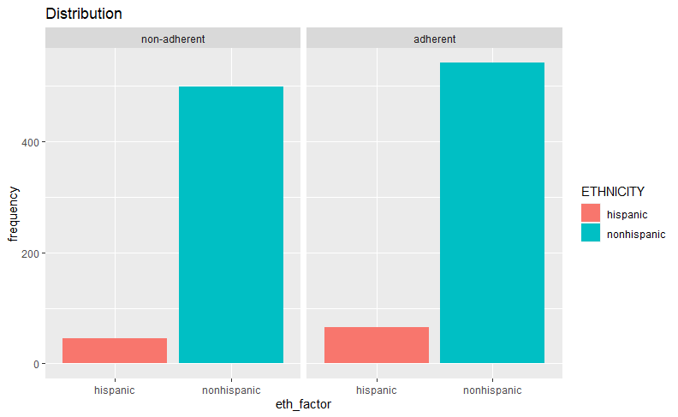
Analytics to find out a. population based upon demographic, ethnicity, gender and so on with highest contribution to non-adherence.

Slide 26
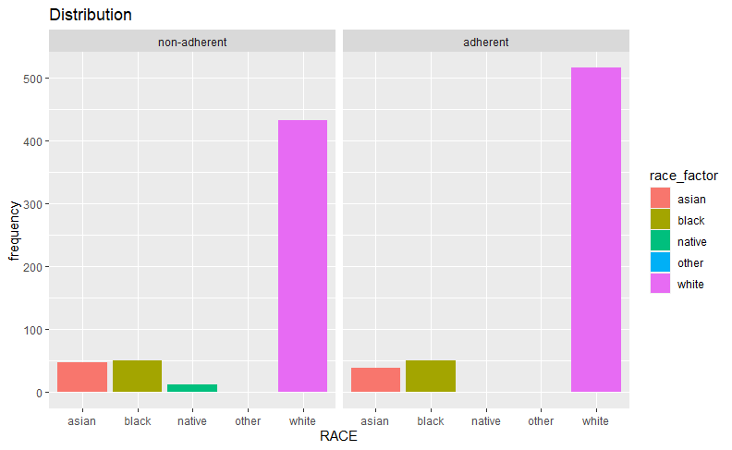
Here the survey clearly shows that people belonging to asain and black races are on the non-adherent sides compared to white .The graph also shows that native races due to less spread of literacy are are non-adherent while taking their medications

Slide 27
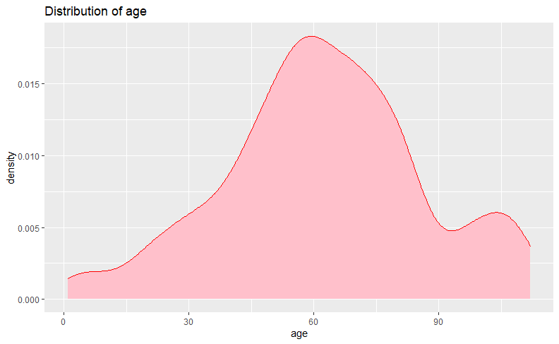
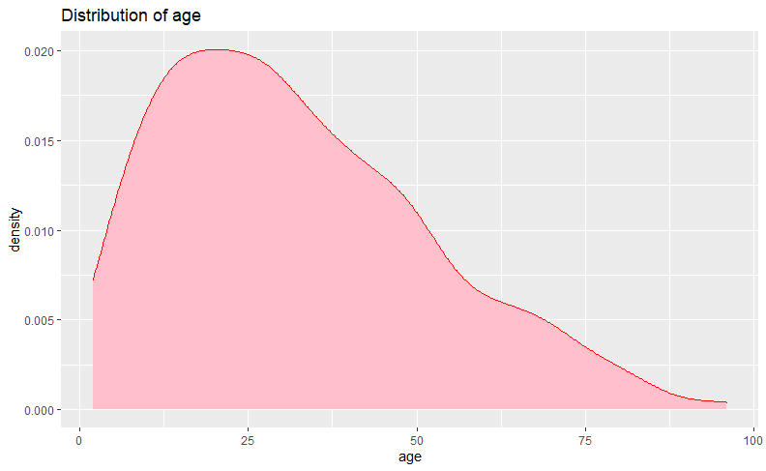
The trends from data shows that people generally during the age after 60 i.e people in their old age tend to be non-adherent towards medication intake

Slide 28
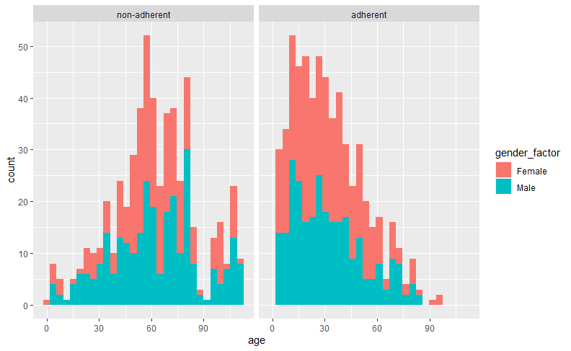
Mostly females around the age 15-35 are more adherent while less number of males of this age group are adherent , while people belonging to the age group of 60-80 are mostly non-adherent

Slide 29
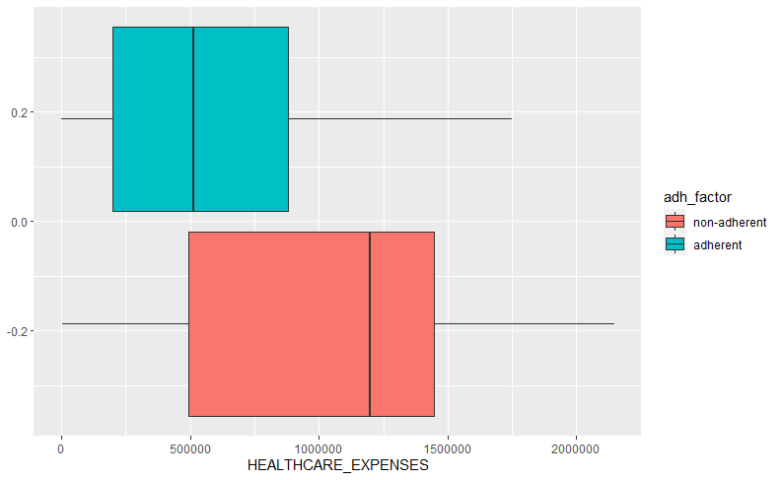
Trends show that non-adherent people also tend to have more expenses due to immaturely discontinuation of medicines.

Slide 30
Thank you
Video Link: https://drive.google.com/file/d/1XRvhmA-v51JAdJUoxWVtNFNVG8fwu2XH/view?usp=sharing
Github Link
https://github.com/joyeetadey/PillPlan-Medicine-Adherence

